Slide 1
Types of Systems
System Analysis and Design
Content 02

Slide 2
Traditional Systems

Slide 3
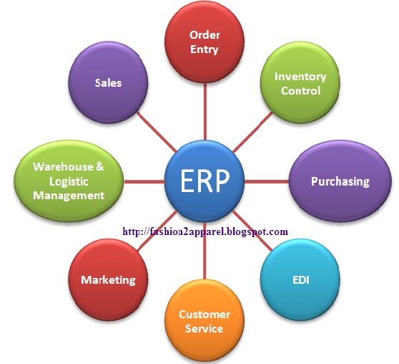
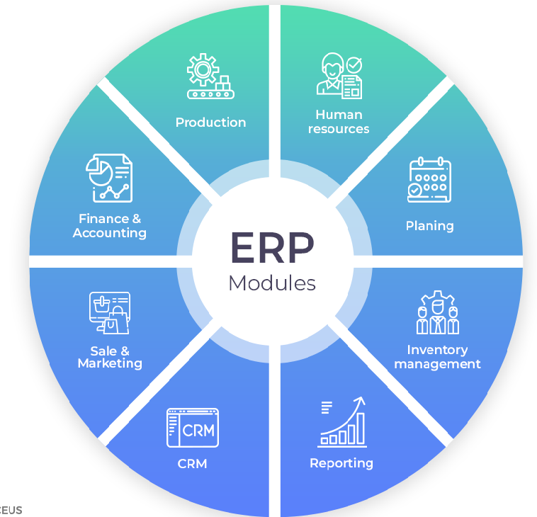
ERP (Enterprise Resource Planning)
Financial management
Customer Relationship Management (CRM)
Manufacturing
Supply Chain Management (SCM)
Inventory
Purchasing
Vehicle etc

Slide 4
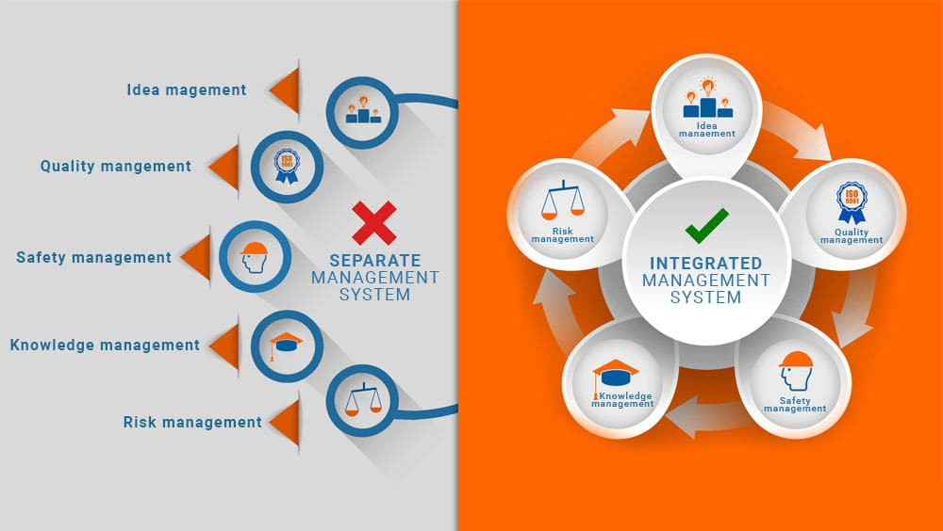
MIS (Management Information Systems):
Short and intermediate range goals
To improve decision-making
To improve efficiency
Day-to-day management

Slide 5
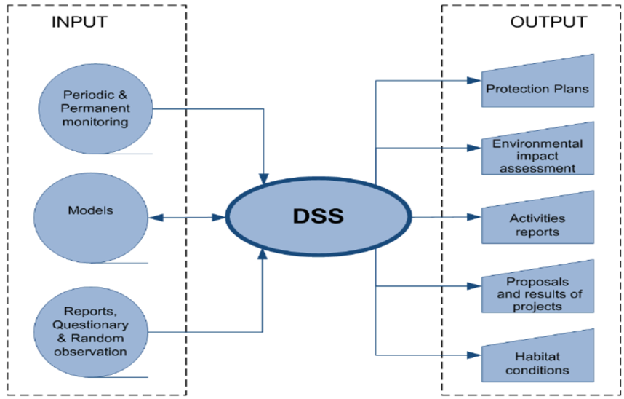
DSS (Decision Support Systems)
Computer-based Information System
Long range data analysis
Projection and Prediction
Assisting in Management Decisions

Slide 6
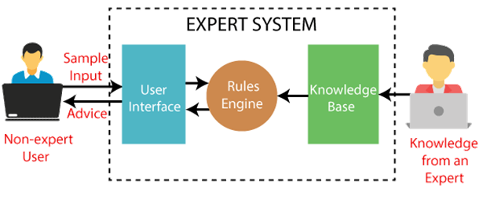
ES (Expert Systems)
Expert services in a specific area
Chess player, cancer expert etc.

Slide 7
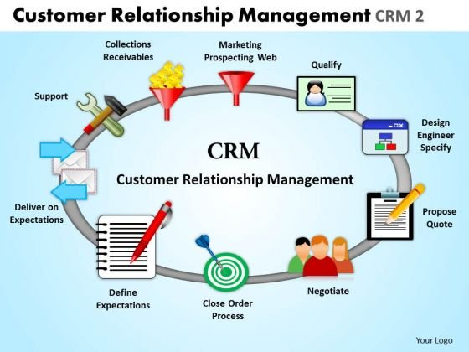
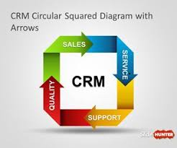
CRM (Customer Relationship Management)
Customer Needs & Satisfaction
Customer Complaints
Customer Service
Customer Retention

Slide 8
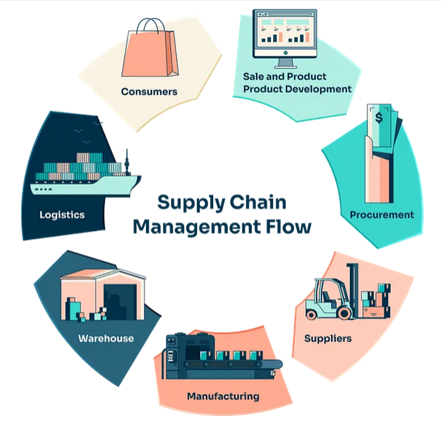
SCM (Supply Chain Management)
Processing Customer Requirements
Inventory Management
Purchase Order Processing
Shipping Management
Supplier Relationship Management

Slide 9
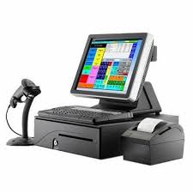
POS System
A POS (Point of Sale) System is a combination of hardware and software used to process sales transactions.
Used in shops, restaurants, supermarkets
Handles billing, printing receipts, and payment
Automatically updates stock after each sale
Helps track daily sales and reports

Slide 10
Modern / Emerging Systems

Slide 11
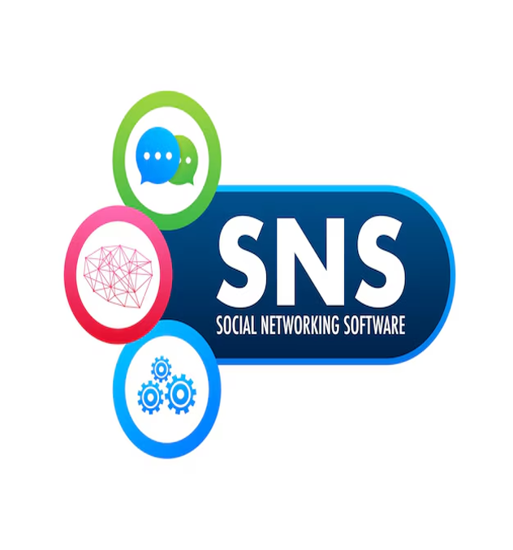
Social Networking
A Social Networking System is an online platform that allows people to create profiles, connect with others, share information, and communicate.

Slide 12
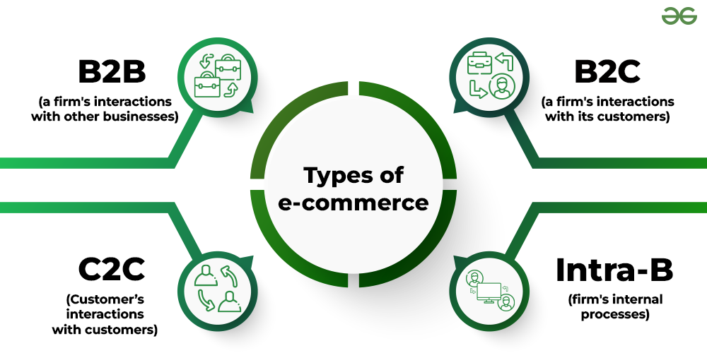
E-commerce Platforms
Online systems that enable buying and selling of goods or services through websites or apps.
B2B (Business-to-Business)
B2C (Business-to-Consumer)
C2C (Consumer-to-Consumer)

Slide 13
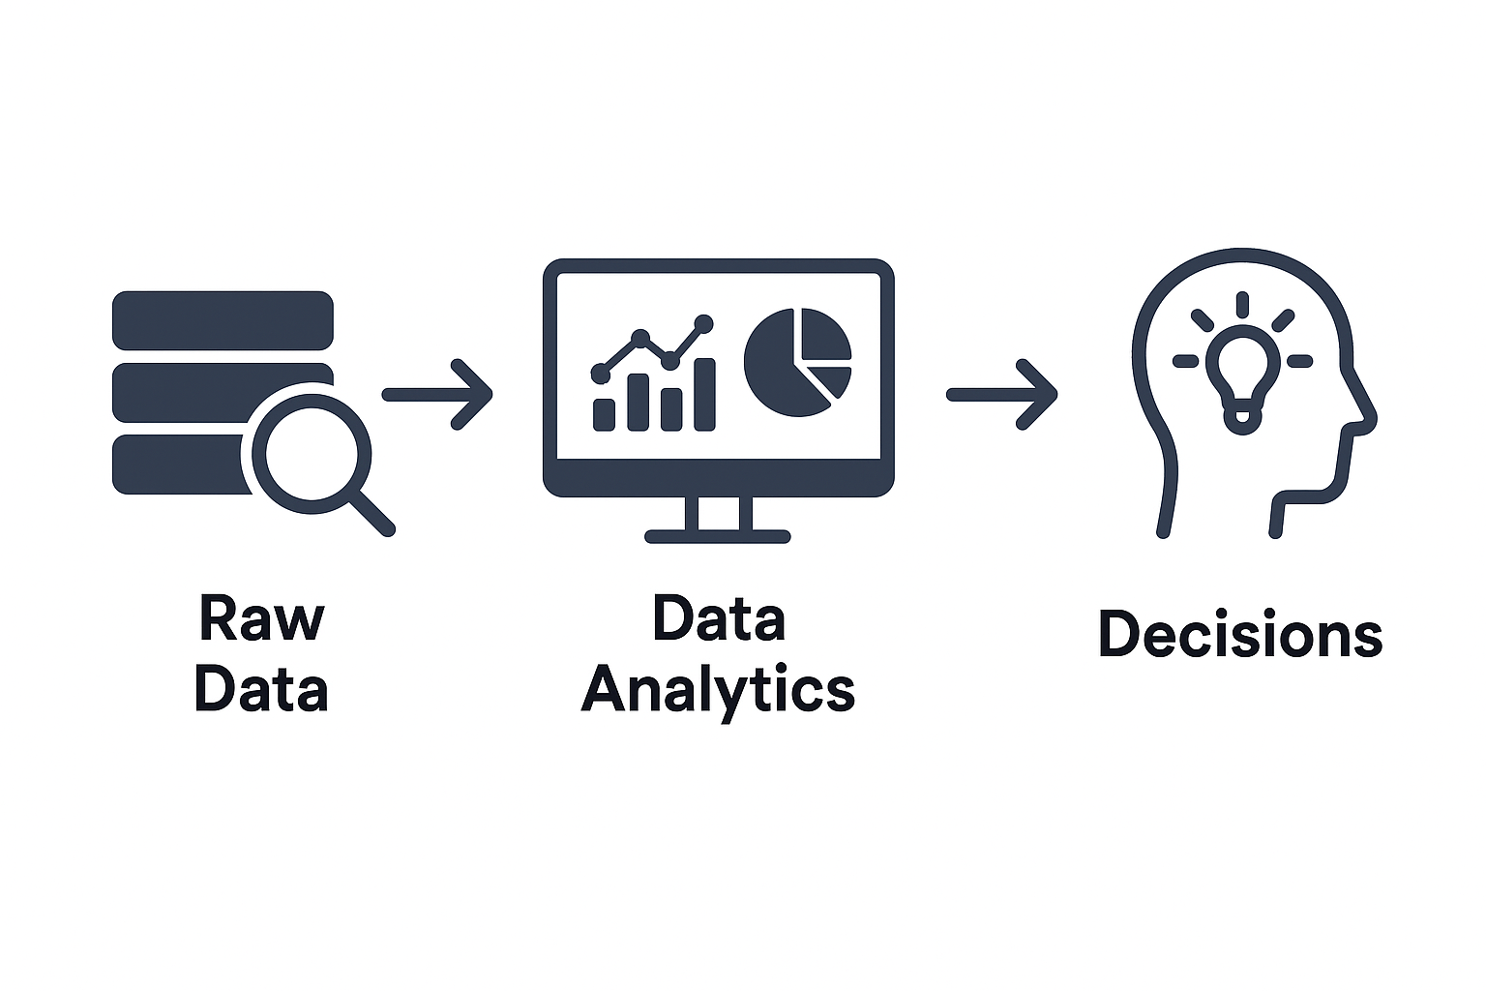
Data Analytics / Business Intelligence (BI)
Data Analytics System: Processes raw data to find patterns, trends, and insights for decision-making.
Business Intelligence (BI) System: Uses data from various sources to help organizations make strategic and operational decisions. BI often involves dashboards, reports, and visualizations.
It’s related to DSS and MIS, but it represents a newer, more advanced form.

Slide 14
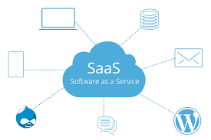
Cloud-based Systems (SaaS)
Software and data are hosted on cloud servers and accessed via the internet instead of local machines.

Slide 15
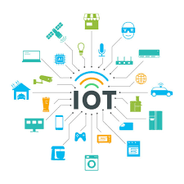
IoT-enabled Systems
IoT-enabled Systems (Internet of Things) is a system where devices (sensors, appliances, machines) are connected to the internet to collect, share, and act on data.
Enable automation, remote monitoring, and smart decision-making.

Slide 16
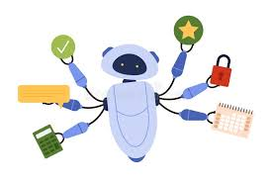
AI-assisted Systems
Systems that use Artificial Intelligence to automate tasks, analyze data, and enhance decision-making.

Slide 17
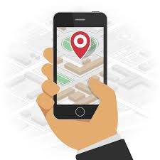
Mobile-centric Systems
Applications and platforms primarily designed for smartphones and tablets.
They offer mobility, push notifications, and location-based services.

Slide 18
Thank You!

